Slide 1
Enerteck Chemical Corporation
EnerBurn Information
January 1, 2022
EnerTeck Chemical Corp. Suite 150 10701 Corporate Dr. Stafford, TX 77477 (281) 240-1787

Slide 2
Corporate Mandate
Enerteck Chemical seeks to promote more efficient diesel fuel consumption and control of the associated emissions from that process through the application of their products.
The company has two primary products, EnerBurn® Diesel Fuel Catalyst and Prohibit™
EnerBurn® is a proven diesel fuel catalyst whose primary benefits are;
Improvement in fuel efficiency
Reduction in emissions
Prolonged useful life of equipment
Prohibit™ is a new product whose primary benefit is to promote a more complete fuel burn and at a lower temperature to reduce the need for active filter re-generation in existing DPF (Diesel Particulate Filter) technology. Using Prohibit will virtually eliminate equipment downtime for DPF regeneration.
EnerTeck Chemical Corp. Suite 150 10701 Corporate Dr. Stafford, TX 77477 (281) 240-1787

Slide 3
EnerBurn® Diesel Fuel Catalyst Development
EnerBurn® is the registered name of the product by Enerteck Corporation but the chemical catalyst was originally developed by Esso Labs (now Exxon Chemical) in the 1980’s as Catane and certified by the EPA. The product was marketed in the 1990’s by a joint venture between Exxon Chemical and Nalco Chemical as EnerBurn. Low oil prices forced the joint venture to put the product on the backburner and Enerteck bought the formula and the rights to the product in 2007.
EnerBurn is registered with the EPA as a diesel fuel performance catalyst. The registration letter can be read here.
EnerBurn has been proven effective in increasing the efficiency of all types of diesel engines and in a multitude of applications. Use of the Enerburn technology will substantially improve the financial performance metrics of your equipment.
EnerTeck Chemical Corp. Suite 150 10701 Corporate Dr. Stafford, TX 77477 (281) 240-1787

Slide 4
EnerBurn® Diesel Fuel Catalyst
EnerBurn® has been proven successful in a variety of industrial applications through field testing of equipment under live conditions. Proving a technology while it is in use in the equipment’s normal course of use is vital to proving the benefits to the customer.
We currently have customers using EnerBurn® to reduce their fuel consumption and control their emission output in the following industries.
Inland Marine Towing
Ocean Marine Towing
Marine Container Shipping
Oil Field Services
Heavy Duty Construction
Short Haul Railroad
Diesel Fueled Electricity Generators
EnerTeck Chemical Corp. Suite 150 10701 Corporate Dr. Stafford, TX 77477 (281) 240-1787

Slide 5
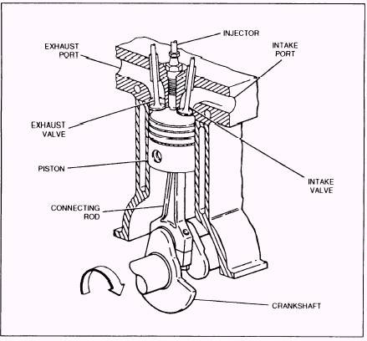
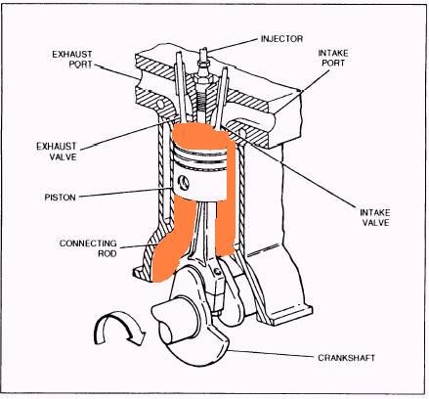
How EnerBurn® Works
EnerBurn® works by conditioning the combustion chamber surfaces with a nano-scale catalytic coating that promotes a more complete burn, effectively doubling the burn rate of the fuel. This leads to higher pressure on crack angle. With more pressure present for the power stroke, more work is created with the equivalent amount of fuel. More work at equal fuel equals greater fuel efficiency. The result of the increase in work conversion is a reduction in exhaust temperature which reduces NOx output. The more complete burn accounts for the reduction of carbon being released via the exhaust and back into the oil as soot. Using EnerBurn® is the ONLY technology available where both NOx and particulates can be reduced concurrently.
← Normal 2 stroke diesel engine
With EnerBurn application area →
EnerTeck Chemical Corp. Suite 150 10701 Corporate Dr. Stafford, TX 77477 (281) 240-1787

Slide 6
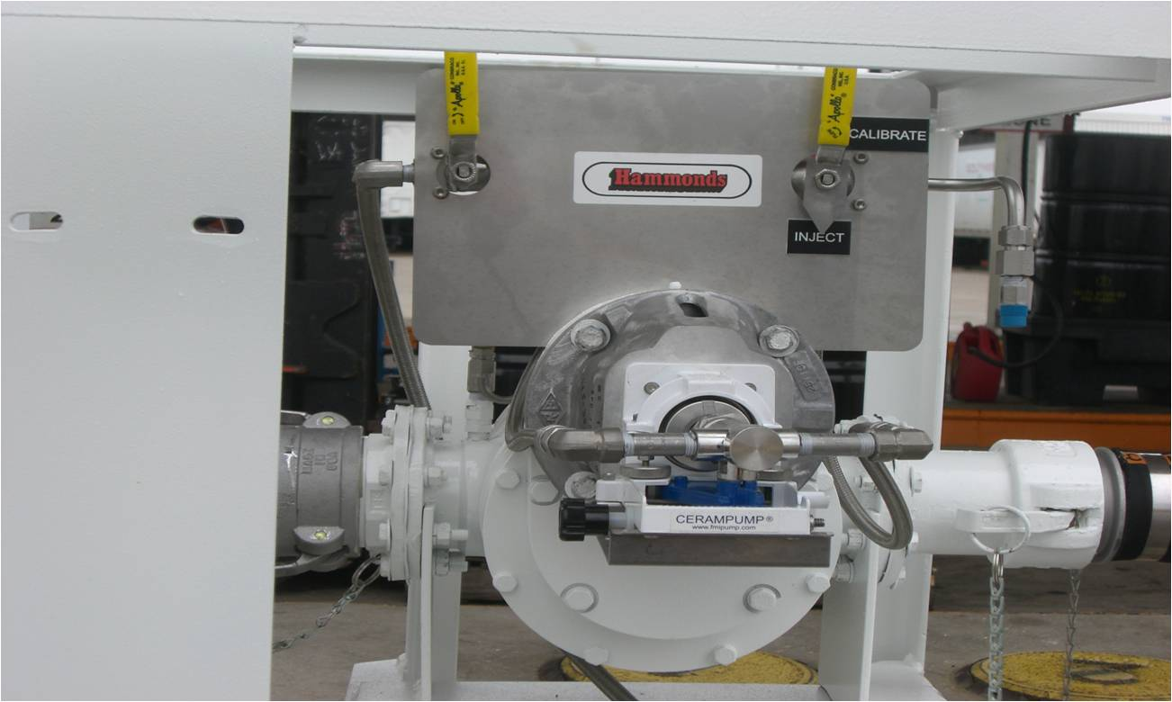
How EnerBurn® Is Implemented
The technology is easily implemented and monitored. Because the catalyst is fuel borne the fuel must be treated with the catalyst. This is accomplished either by working with fuel suppliers to deliver pre-treated fuel or by installing chemical injection equipment at the fuel tank site so that the fuel can be treated at the proper ratio upon delivery.
Our chemical injection equipment is manufactured and designed by Hammonds (hammondscos.com) and is military grade injection equipment. To date we have had no issues with any of our units in the field. The equipment is reliable and accurate.
EnerTeck Chemical Corp. Suite 150 10701 Corporate Dr. Stafford, TX 77477 (281) 240-1787

Slide 7
How Do I Benefit By Using EnerBurn®
Product Benefits
Benefit Range
Improved Fuel Efficiency
Reduces Equipment Downtime
Reduces Oxides of Nitrogen (NOx)
Reduces Stack Emissions
Reduces Lube Oil Consumption
Proven from 7-12%
Average of 25-35%
Proven from 8-12%
Proven from 40-70%
Proven from 35-50%
Note: Most test results available for review and all benefit ranges from actual field evaluations.
EnerTeck Chemical Corp. Suite 150 10701 Corporate Dr. Stafford, TX 77477 (281) 240-1787

Slide 8
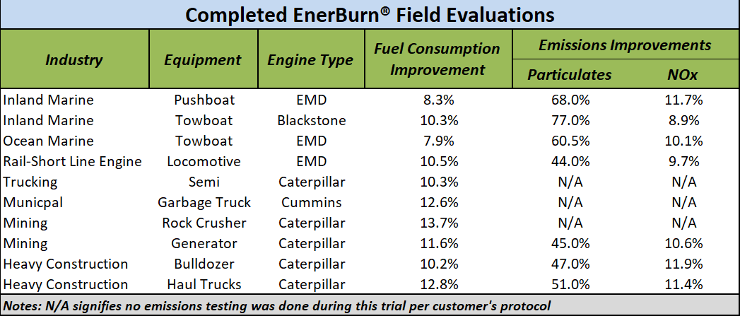
EnerBurn® Evaluation Results
Completed EnerBurn® Evaluations as of August, 2019
EnerTeck Chemical Corp. Suite 150 10701 Corporate Dr. Stafford, TX 77477 (281) 240-1787

Slide 9
EnerBurn Effect on Combustion
Increases rate of burning.
Wall effect promotes complete combustion.
Mechanical fuel injection. Red Curve is Treated – Black is Untreated.
PRESSURE
0
7
20
CRANK ANGLE (0 = TDC)
EnerBurn works by increasing the burn rate when the flame front reaches the wall at 5-7° after TDC.
EnerTeck Chemical Corp. Suite 150 10701 Corporate Dr. Stafford, TX 77477 (281) 240-1787

Slide 10
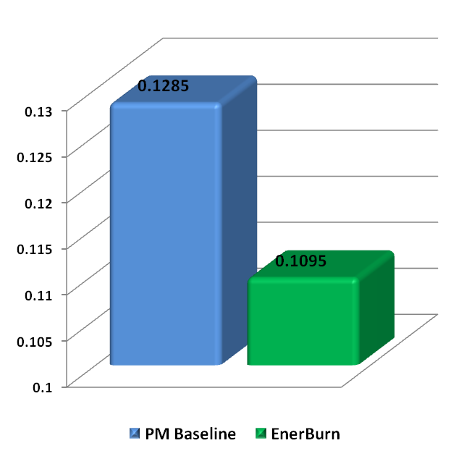
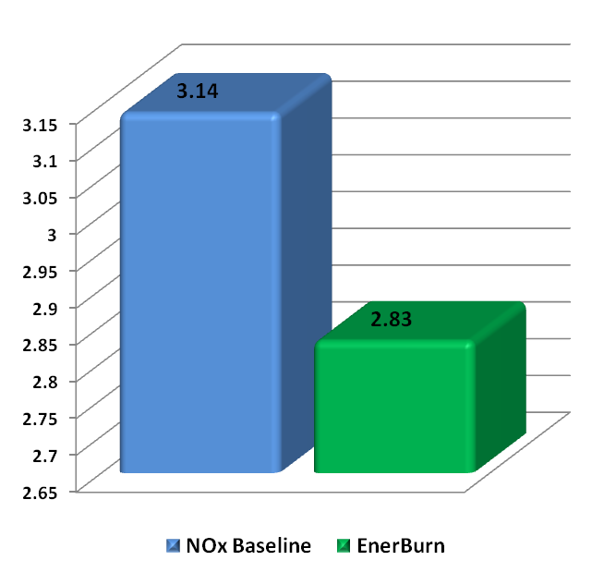
NOx and Particulates Emissions Results
NOx Emissions
(gm/mile)
Particulate Emissions
(gm/mile)
EnerTeck Chemical Corp. Suite 150 10701 Corporate Dr. Stafford, TX 77477 (281) 240-1787

Slide 11
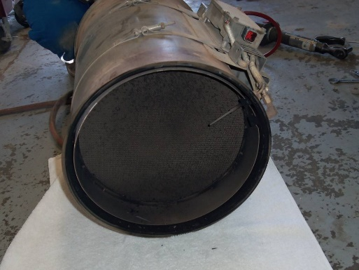
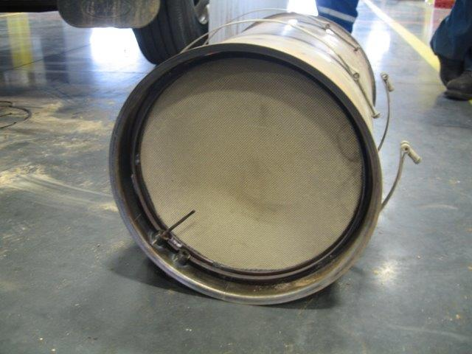
EnerBurn Effect On Diesel Particulate Filters
EnerBurn, due to its ability to promote a more complete fuel burn, is a highly effective technology to improve Diesel Particulate Filter performance. DP Filters are prone to have to re-generate themselves, this causes substantial equipment downtime which is financially unproductive, and in some applications (fracking et al) it is dangerous.
Untreated DP Filter
Close up view of clean filter after 3 months of EnerBurn use and ZERO re-gens in that period! This filter was on a fracking pressure pumper that runs 24/7.
DP Filter treated for 3 months
EnerTeck Chemical Corp. Suite 150 10701 Corporate Dr. Stafford, TX 77477 (281) 240-1787

Slide 12
EnerBurn Effect on Cylinder Pressure as a Function of Crank Angle
The rate of fuel combustion is increased as the flame front reaches the wall at 5-7° after TDC.
The catalytic wall effect allows for more complete combustion earlier in the combustion cycle.
Maximum cylinder pressure is reduced.
Electronic fuel injection
EnerTeck Chemical Corp. Suite 150 10701 Corporate Dr. Stafford, TX 77477 (281) 240-1787

