Slide 1
Enerteck Chemical Corporation
Bulk Tank Manual Dosing Giudelines
September 1, 2022
Enerteck Chemical Corp. Suite 150 10701 Corporate Dr. Stafford, TX 77477 (281) 240-1787

Slide 2
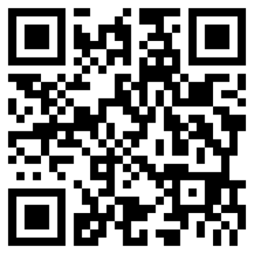
Scan the code to watch the video of this presentation
A Fuel Borne Combustion Catalyst
Bulk Tank Hand Dosing Procedure
Enerteck Chemical Corp. Suite 150 10701 Corporate Dr. Stafford, TX 77477 (281) 240-1787

Slide 3
How Enerburn Works
ENERBURN IS A FUEL BORNE COMBUSTION ACCELERATOR
EnerBurn works by conditioning the combustion chamber surfaces with a nano-scale catalytic coating that doubles the rate of combustion of the fuel molecules.
10,000 x Magnification
Enerteck Chemical Corp. Suite 150 10701 Corporate Dr. Stafford, TX 77477 (281) 240-1787

Slide 4
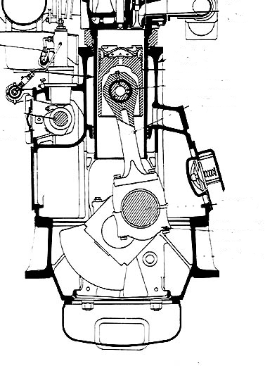
How Enerburn Works (Part 2)
This causes higher pressure earlier on crank angle which allows the engine to produce more work (HP) with the same amount of fuel. With the workload being the same, this translates into greater fuel efficiency (gph).
Work Begins With EnerBurn
Work Begins Without EnerBurn
Enerteck Chemical Corp. Suite 150 10701 Corporate Dr. Stafford, TX 77477 (281) 240-1787

Slide 5
Working with the Enerburn Catalyst
Key Points when Working with the
EnerBurn Combustion Catalyst
Safety
Handle EnerBurn just as you would diesel fuel.
Read and understand the EnerBurn SDS.
Wear proper PPE when working with EnerBurn.
Clean up any spills promptly using the same techniques as for diesel fuel.
Enerteck Chemical Corp. Suite 150 10701 Corporate Dr. Stafford, TX 77477 (281) 240-1787

Slide 6
Working with the Enerburn Catalyst
Key Points when Working with the
EnerBurn Combustion Catalyst
Handling
Store Enerburn indoors
Water that accumulates on the tops of the drums can be drawn through tightly closed bungs or spigots by the daily pressure changes from heating/cooling cycles.
Water accumulation can also rust the drum lid and potentially allow water to seep into the drum.
Protect EnerBurn from extreme cold and heat prior to use
Enerburn will freeze and crystallize under 32°F, please store it between 50°-120°F
Enerburn has a 20-year shelf life if stored properly
Enerteck Chemical Corp. Suite 150 10701 Corporate Dr. Stafford, TX 77477 (281) 240-1787

Slide 7
Working with the Enerburn Catalyst
Key Points when Working with the
EnerBurn Combustion Catalyst
Dispensing
EnerBurn mixes instantly and completely with diesel fuel. No mixing is required.
Avoid splashing and spilling while dispensing.
Use the closures on the transfer container when moving EnerBurn from the drum to the bulk tank.
Be as accurate as you can when dosing fuel with EnerBurn.
Use the closures on the transfer container when not in use to prevent contamination.
Use the drum cradle to return the EnerBurn drum to the upright position when
finished dispensing to avoid spills.
Enerteck Chemical Corp. Suite 150 10701 Corporate Dr. Stafford, TX 77477 (281) 240-1787

Slide 8
Working with the Enerburn Catalyst
Proper Dosing of your Fuel – Dosing Ratio
· The Dosing Ratio of EnerBurn is 1:2500
· Therefore, 1 gallon of EnerBurn will treat 2500 gallons of
diesel fuel.
· For smaller amounts, 1 ounce of EnerBurn will treat 20 gallons of fuel.
· A simple equation to determine the proper dosing is:
(Quantity of fuel in gallons) / 20 = #ounces of EnerBurn required.
Example: 1000 gallons / 20 = 50 ounces of EnerBurn
Enerteck Chemical Corp. Suite 150 10701 Corporate Dr. Stafford, TX 77477 (281) 240-1787

Slide 9
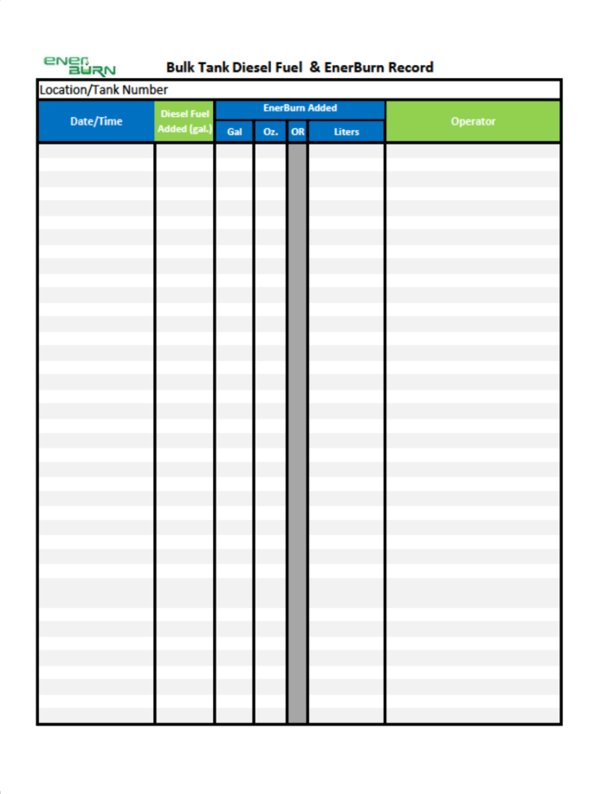
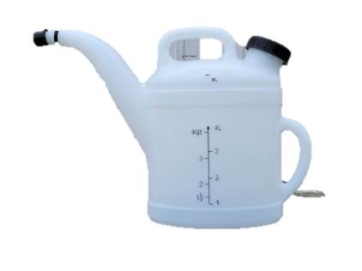
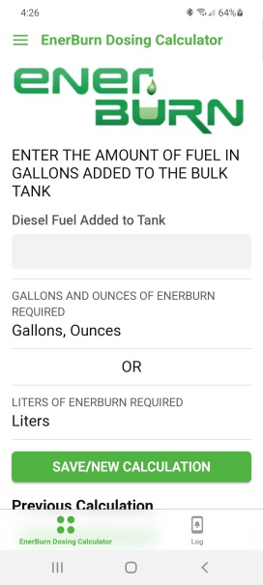
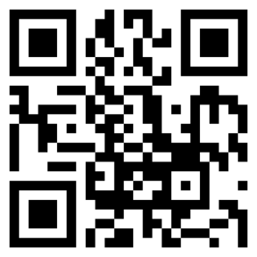
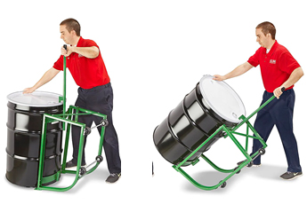
Working with the Enerburn Catalyst
Proper Dosing of your Fuel – Items Required
Dosing Chart
Transfer Container
Fueling Record
Or
EnerBurn Dosing App
Drum Spigot
Scan to get the EnerBurn Dosing App
Tilting Drum Cradle
All of these items will be provided by EnerTeck
Enerteck Chemical Corp. Suite 150 10701 Corporate Dr. Stafford, TX 77477 (281) 240-1787

Slide 10
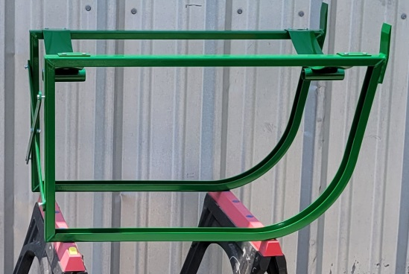
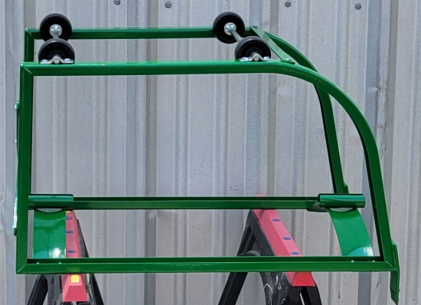
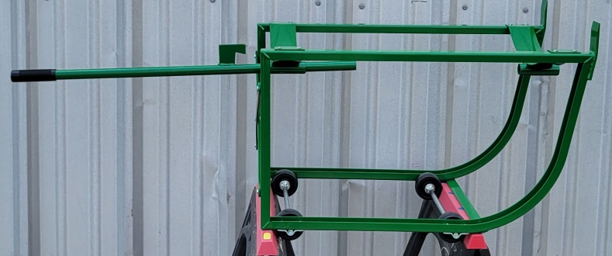
Working with the Enerburn Catalyst
Proper Dosing of your Fuel – Drum Cradle
Assemble the Tilting Drum Cradle using the instructions included in the box.
Install the Drum Spigot in the ¾” drum bung.
Enerteck Chemical Corp. Suite 150 10701 Corporate Dr. Stafford, TX 77477 (281) 240-1787

Slide 11
Dosing Your Fuel
Proper Dosing of your Fuel – Dosing Chart
Note the amount of diesel added when fueling the unit. This is only fuel dispensed, not the total volume of the tank.
Use the Dosing Chart to determine the amount of EnerBurn to dose. Always round up to the next available amount on the Dosing Table. (i.e., Round 7458 gallons to 7500 gallons on the Dosing Table.)
NOTE:
It is easier and more accurate to use liters when dosing EnerBurn in larger quantities.
Enerteck Chemical Corp. Suite 150 10701 Corporate Dr. Stafford, TX 77477 (281) 240-1787

Slide 12
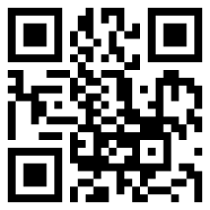
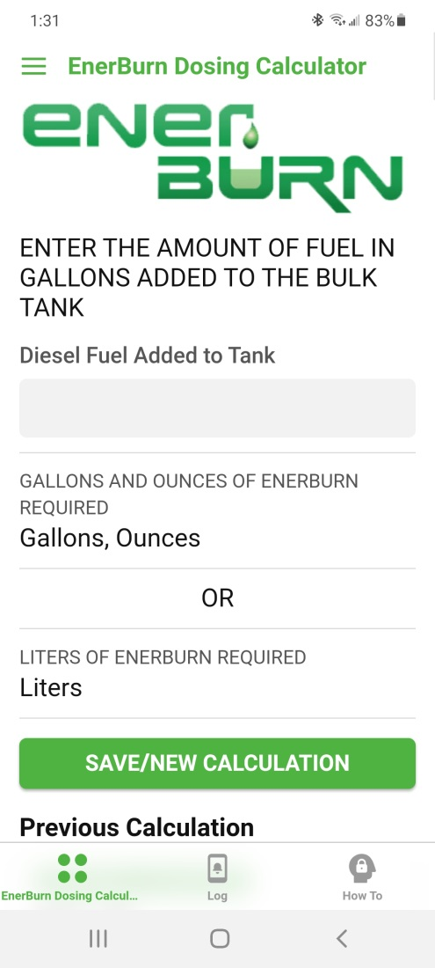
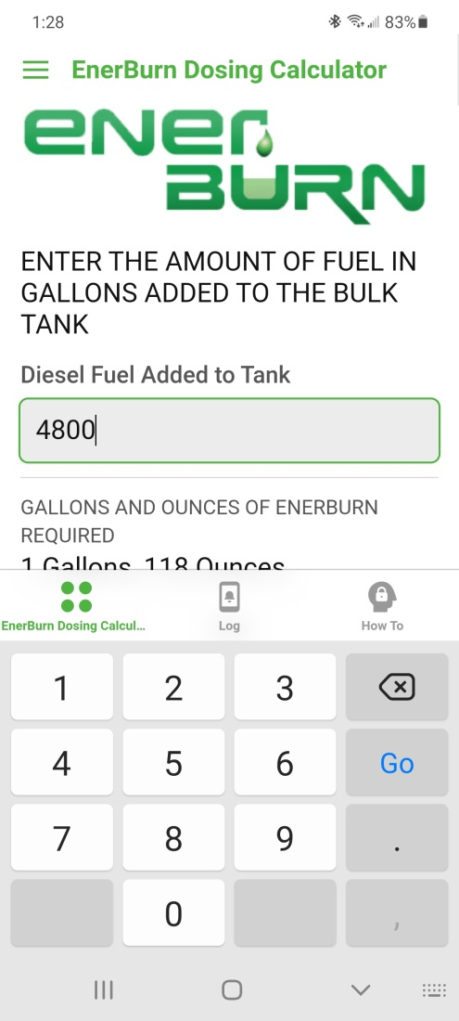
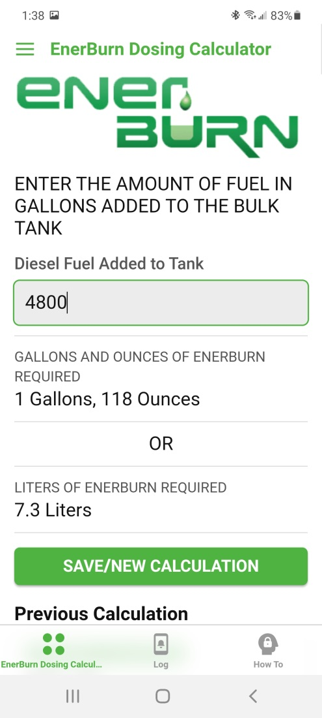
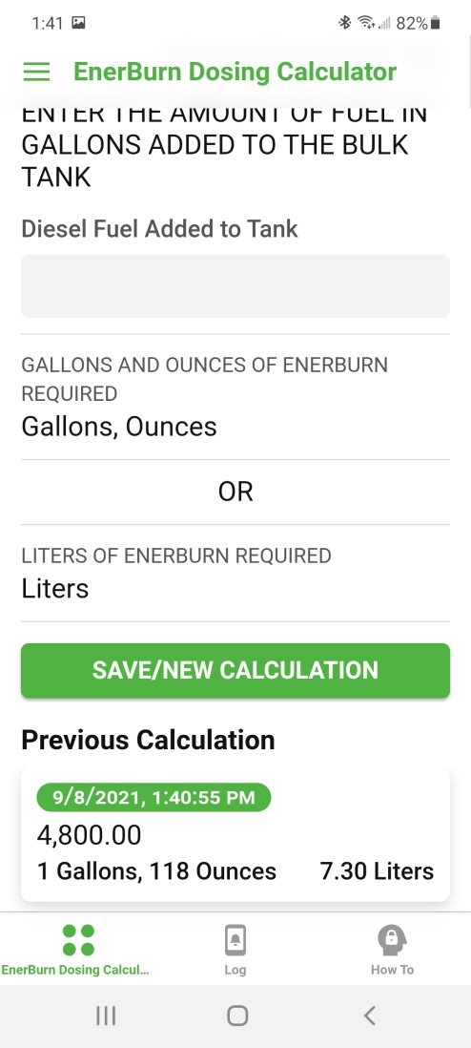
Dosing Your Fuel
Proper Dosing of your Fuel – Dosing App
Get the EnerBurn Dosing App
The amount of EnerBurn required is displayed
Hit Save/New Calc to clear. Previous Calc is shown at the bottom
Enter the amount of fuel added
Enerteck Chemical Corp. Suite 150 10701 Corporate Dr. Stafford, TX 77477 (281) 240-1787

Slide 13
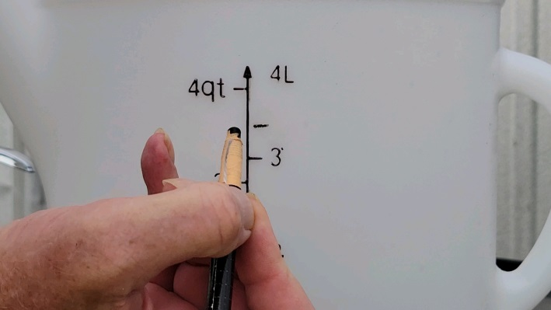
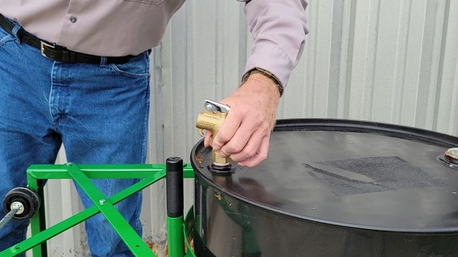
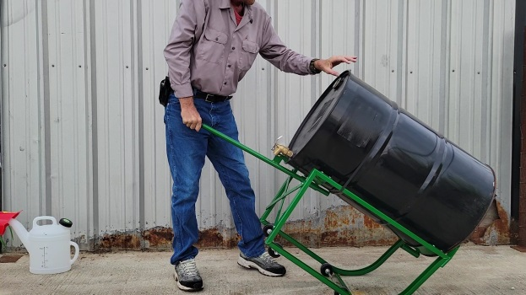
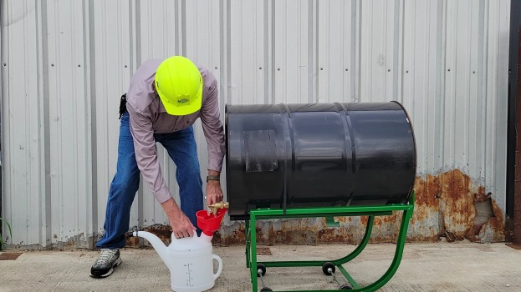
Dosing Your Fuel
Proper Dosing of your Fuel – Measuring a Dose
Using the 4,800-gallon fuel delivery from the previous slide, the EnerBurn dose will be 7.3 liters
With our 4-liter Transfer Container that will be one 4-liter fill and one 3.3-liter fill.
A handy tip:
Use a grease pencil or a piece of tape to mark the 10th of a liter level.
First, equalize the drum pressure by operating the spigot.
Position the Transfer Container under the spigot.
Carefully tilt the drum to the horizontal position
Enerteck Chemical Corp. Suite 150 10701 Corporate Dr. Stafford, TX 77477 (281) 240-1787

Slide 14
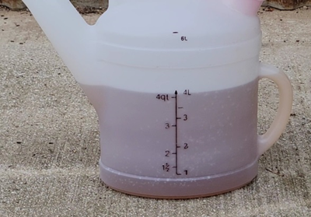
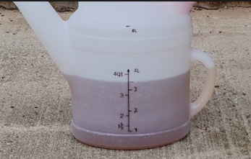
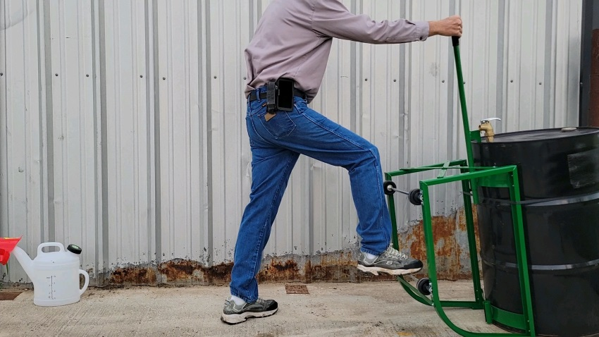
Dosing Your Fuel
Proper Dosing of your Fuel – Measuring a Dose Cont’d
Place the cap on the container to prevent spills.
Dispense the EnerBurn to the 4-liter mark.
Pour the EnerBurn directly into the diesel fuel in the bulk tank
Follow the same procedure for the remaining 3.3 liters
Then stand the drum upright
Enerteck Chemical Corp. Suite 150 10701 Corporate Dr. Stafford, TX 77477 (281) 240-1787

Slide 15
Record Keeping
Fill out the EnerBurn Fueling Record completely and accurately
Enerteck Chemical Corp. Suite 150 10701 Corporate Dr. Stafford, TX 77477 (281) 240-1787

Slide 16
Microbial Effects on Fuel Infused with EnerBurn
Enerteck Chemical Corp. Suite 150 10701 Corporate Dr. Stafford, TX 77477 (281) 240-1787

Slide 17
Enerburn Dosing Chart
Enerteck Chemical Corp. Suite 150 10701 Corporate Dr. Stafford, TX 77477 (281) 240-1787

Slide 18
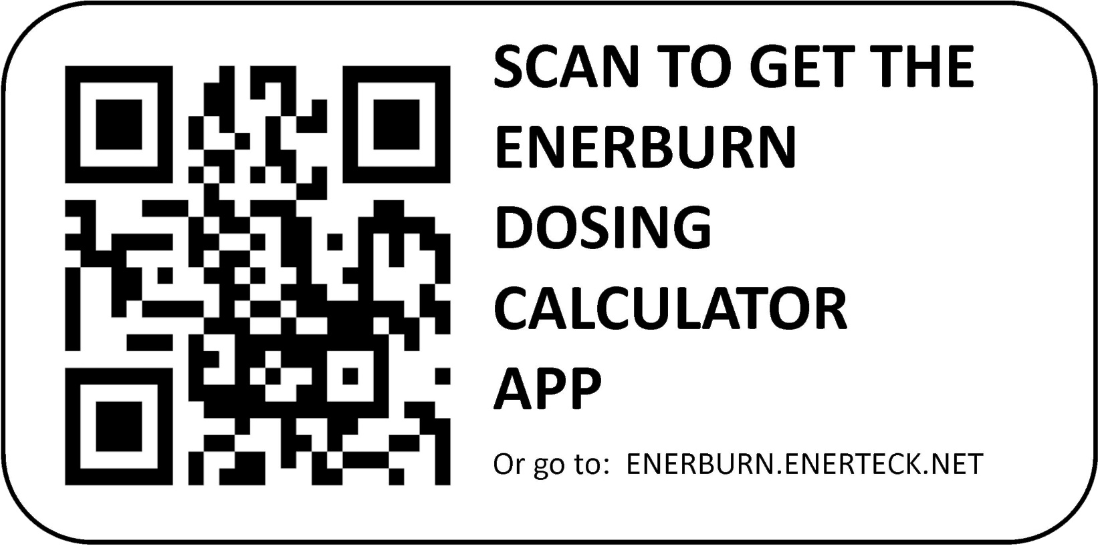
EnerBurn Dosing App
If you have any questions, please contact us at:
281-240-1795 or ppeterson@enerteck.net
Enerteck Chemical Corp. Suite 150 10701 Corporate Dr. Stafford, TX 77477 (281) 240-1787

